Slide 1
Deep Learning Lecture 4 – Sequence Models

Slide 2
OVERVIEW of Today
Schedule:
AT1B Check in
Intro to Sequence Models
RNN/LSTMs
Attention
Lab/Lecture:
NLP & Deep Learning in industry: Steve Nouri, Head of A.I at Nod.

Slide 3
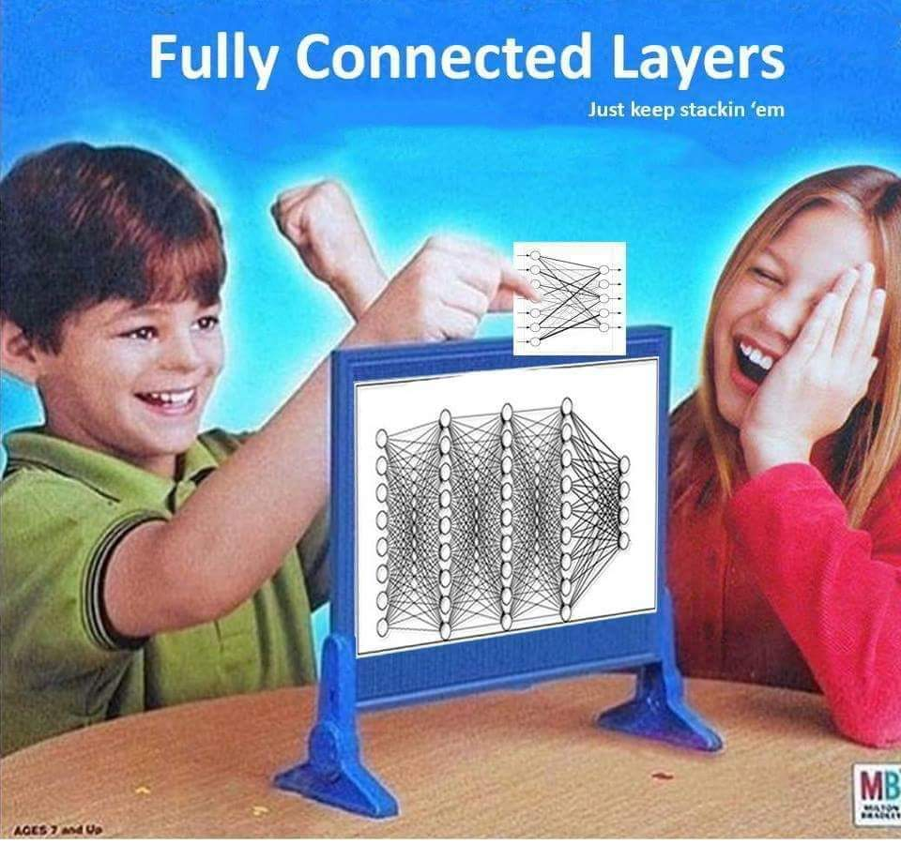
AT1b Check in
How is it all going?

Slide 4
Introduction to Sequence models
Source
We have so far been working with one-to-one, even with out images.
There is also:
One-to-many (Image captioning)
Many to one (Sentiment analysis on a sentence)
Many to many with variable length I/O (Language translation)
Many to many with variable input but single classification per input (video frame classification)

Slide 5
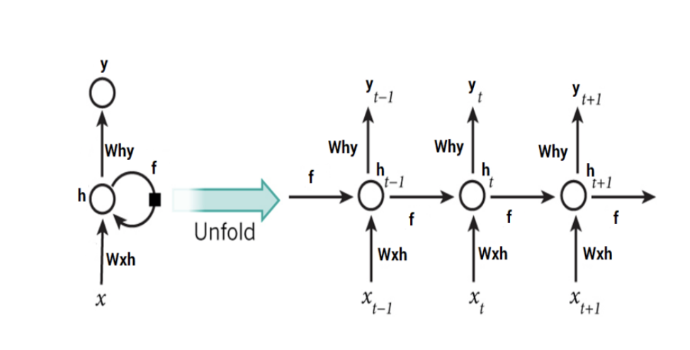
Introducing RNNs
source
An RNN is a network architecture that can deal with this.
Originally proposed in ‘that’ backprop paper (Rumelhart et al, 1986)
A vanialla RNN is seen in compact (left) and unrolled (right) diagrams. Both represent the same thing.
The neuron has a hidden state
The hidden state is updated when an input vector X at every time point is added.
There are two weight matrices, one on input and one on output

Slide 6
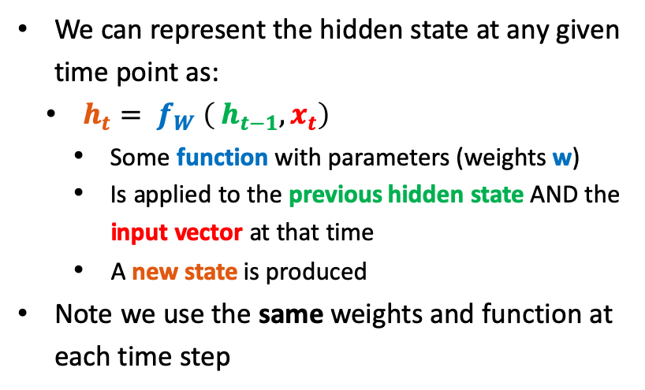
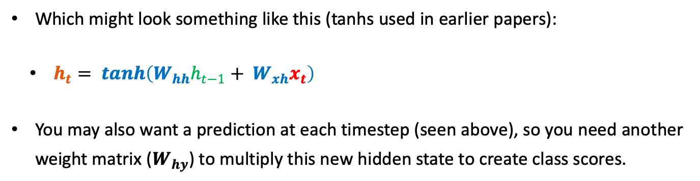
Introducing RNNs – The maths
We can represent the hidden state at any given time point as:
$h_{t}= f_{W} \left( h_{t−1}, x_{t}\right)$
Some function with parameters (weights w)
Is applied to the previous hidden state AND the input vector at that time
A new state is produced
Note we use the same weights and function at each time step
Typically H₀ initalised to zeros
Which might look something like this (tanhs used in earlier papers):
$h_{t}= tanh\left(W_{hh}h_{t−1}+ W_{xh}x_{t}\right)$
You may also want a prediction at each timestep (seen above), so you need another weight matrix ($W_{hy}$) to multiply this new hidden state to create class scores.
Notes:
Some other nice diagrams here https://medium.com/@jianqiangma/all-about-recurrent-neural-networks-9e5ae2936f6e

Slide 7
RNN Computational Graph
We can represent the different RNN types as computational graphs
Source
A Many to Many RNN computational graph. The multiple losses mean a final loss summation to get a total loss as well as an additive operation to sum gradients into the final weight matrix during back prop.
A Many to One RNN computational graph. There is only one output, but it has elements of everything that has come before it. Hence only one loss
A One to Many RNN computational graph. Similar to Many to Many but only one input X.

Slide 8

A fun RNN example
An infamous paper/example by Andrej Karpathy – ‘The unreasonable Effectiveness of RNNs’ (source)
A character-level RNN to generate text.
“To examine this I downloaded all the works of Shakespeare and concatenated them into a single (4.4MB) file. We can now afford to train a larger network, in this case lets try a 3-layer RNN with 512 hidden nodes on each layer. After we train the network for a few hours we obtain samples such as:”

Slide 9
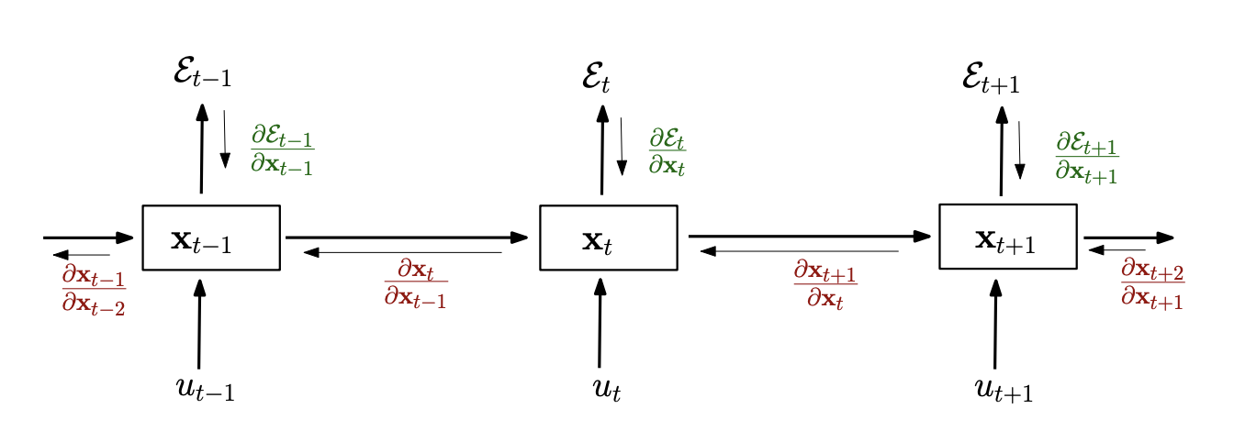
Training RNNs
There is little new knowledge required here, we forward prop as noted and backprop using optimisers we know about.
The only twist we need to know about is ’Backpropagation Through Time’ (source) where we need to do a summation of gradients after unrolling the RNN.
source

Slide 10
Training RNN Issues
The training becomes computationally expensive (and slow!) as the number of time positions increases.
Additionally there are exploding gradients and vanishing gradients (Bengio et al, 1994. Here). Over a long enough time period:
If the weight matrix is >1, the gradients explode
If the weight matrix is <1, the gradients vanish
See below, the backwards (red) path, we will multiply by transpose of weight matrix for each RNN unit. Over long time periods, this becomes an issue.
source

Slide 11
Training RNN Issues
We can fix this with:
Gradient clipping & constraints for exploding/vanishing (Source, Bengio et al 2012)
Truncated back prop through time (only going back or forward a certain amount)
Batch norm difficult (but ongoing research area) due to time component in minibatch
“the summed inputs to the recurrent neurons in a recurrent neural network (RNN) often vary with the length of the sequence so applying batch normalization to RNNs appears to require different statistics for different time-steps” (Source, Hinton et al 2016)
Change the architecture…..
See also: GRU (Cho et al, 2014 source)

Slide 12
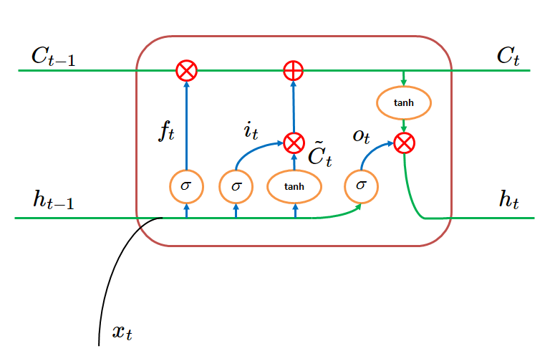
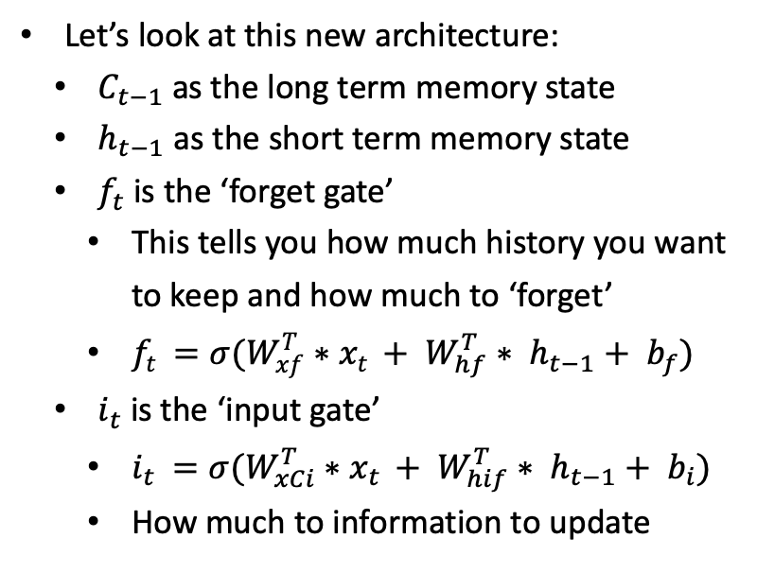
Introducing LSTM
Long Short Term Memory (Hochreiter & Schmidhuber, 1997 source) proposes a solution to the RNN gradient vanishing problem by a slightly more complex architecture.
Let’s look at this new architecture:
$C_{t−1}$ as the long term memory state
$h_{t−1}$ as the short term memory state
$f_{t}$is the ‘forget gate’
This tells you how much history you want to keep and how much to ‘forget’
$f_{t }=σ({W_{xf}^{T}∗x}_{t }+ W_{hf}^{T}∗ h_{t−1}+ b_{f})$
$i_{t}$ is the ‘input gate’
$i_{t }=σ({W_{xCi}^{T}∗x}_{t }+ W_{hif}^{T}∗ h_{t−1}+ b_{i})$
How much to information to update
source

Slide 13
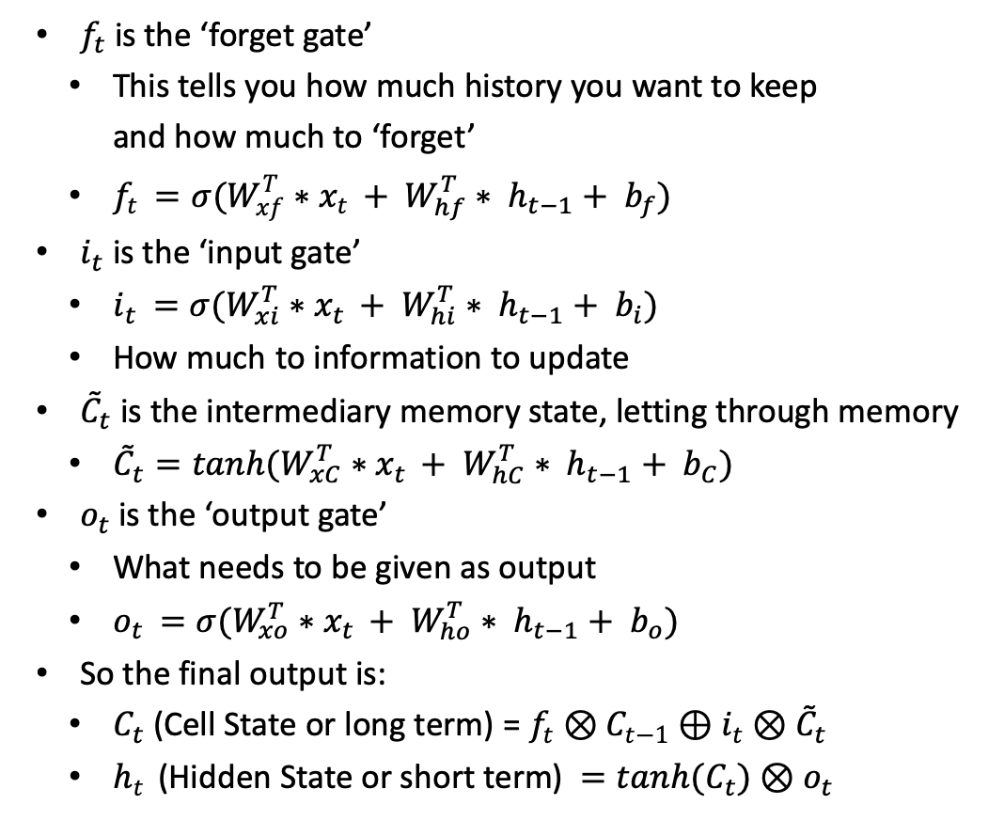
Introducing LSTM
$f_{t}$is the ‘forget gate’
This tells you how much history you want to keep and how much to ‘forget’
$f_{t }=σ({W_{xf}^{T}∗x}_{t }+ W_{hf}^{T}∗ h_{t−1}+ b_{f})$
$i_{t}$ is the ‘input gate’
$i_{t }=σ({W_{xi}^{T}∗x}_{t }+ W_{hi}^{T}∗ h_{t−1}+ b_{i})$
How much to information to update
${\tilde{C}}_{t}$ is the intermediary memory state, letting through memory
${\tilde{C}}_{t}=tanh({W_{xC}^{T}∗x}_{t }+ W_{hC}^{T}∗ h_{t−1}+ b_{C})$
$o_{t}$ is the ‘output gate’
What needs to be given as output
$o_{t }=σ({W_{xo}^{T}∗x}_{t }+ W_{ho}^{T}∗ h_{t−1}+ b_{o})$
So the final output is:
$C_{t}$ (Cell State or long term) = $f_{t}⊗C_{t−1}⊕i_{t}⊗{\tilde{C}}_{t}$
$h_{t }$ (Hidden State or short term) $=tanh(C_{t})⊗o_{t}$

Slide 14
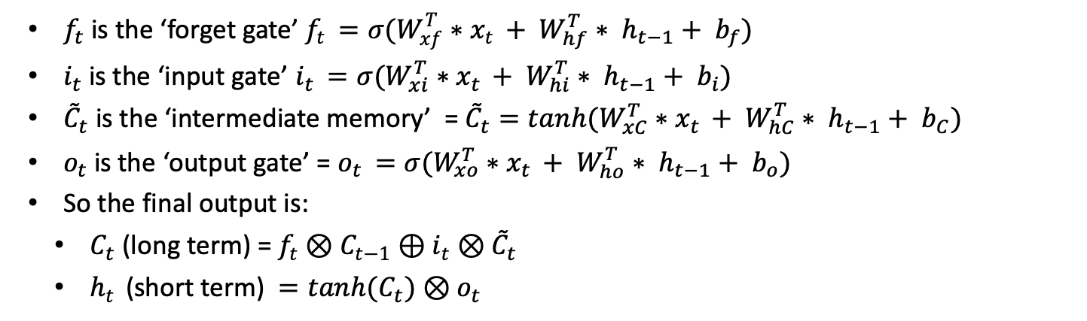
LSTM IN Summary
$f_{t}$is the ‘forget gate’ $f_{t }=σ({W_{xf}^{T}∗x}_{t }+ W_{hf}^{T}∗ h_{t−1}+ b_{f})$
$i_{t}$ is the ‘input gate’ $i_{t }=σ({W_{xi}^{T}∗x}_{t }+ W_{hi}^{T}∗ h_{t−1}+ b_{i})$
${\tilde{C}}_{t}$ is the ‘intermediate memory’ = ${\tilde{C}}_{t}=tanh({W_{xC}^{T}∗x}_{t }+ W_{hC}^{T}∗ h_{t−1}+ b_{C})$
$o_{t}$ is the ‘output gate’ = $o_{t }=σ({W_{xo}^{T}∗x}_{t }+ W_{ho}^{T}∗ h_{t−1}+ b_{o})$
So the final output is:
$C_{t}$ (long term) = $f_{t}⊗C_{t−1}⊕i_{t}⊗{\tilde{C}}_{t}$
$h_{t }$ (short term) $=tanh(C_{t})⊗o_{t}$
The forget gate is multiplied element wise by the intermediate cell state. Hence at extreme values (0’s and 1’s) it can forget which cells to forget.
Similar logic applies to input and intermediate memory gate.

Slide 15
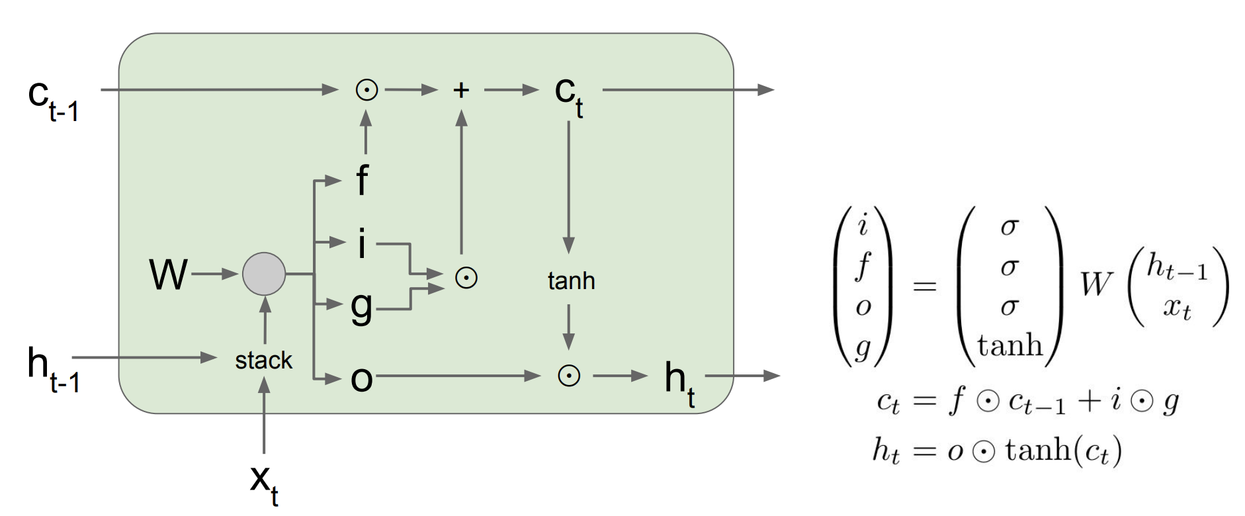
AN ALTERNATE LSTM DIAGRAM
source
We can see in the previous formulae that there are a lot of similar operations happening (Weight matrices multiplying by the same things) and then activations over that.
In fact this would be stacked for computation, so we can view a more compact version.
Note: In this version, the intermediary memory is called the ‘gate gate’ (….)

Slide 16
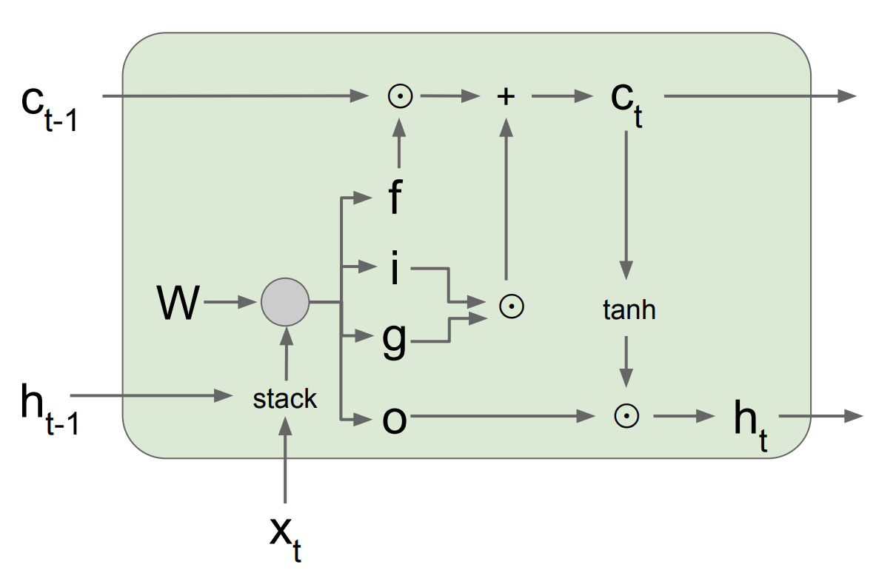
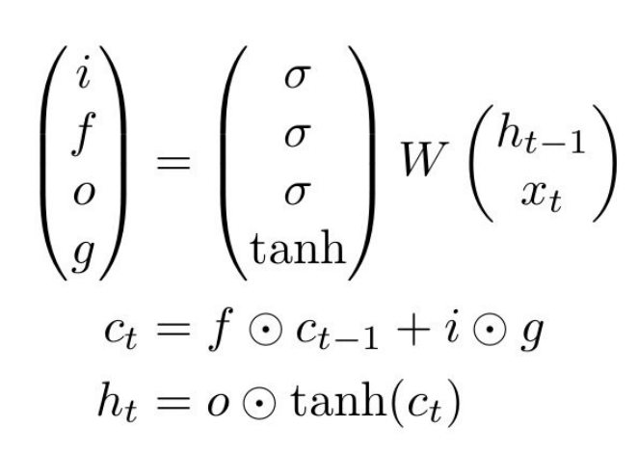
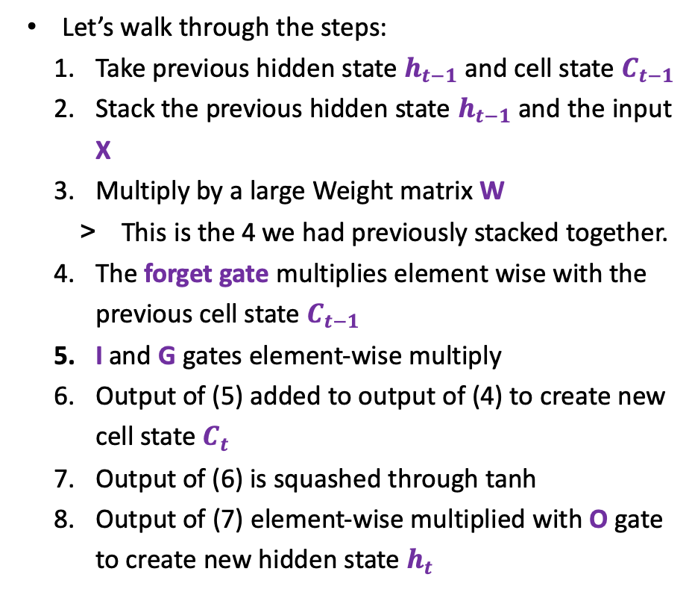
AN ALTERNATE LSTM DIAGRAM
source
Let’s walk through the steps:
Take previous hidden state $h_{t−1}$and cell state $C_{t−1}$
Stack the previous hidden state $h_{t−1}$ and the input X
Multiply by a large Weight matrix W
This is the 4 we had previously stacked together.
The forget gate multiplies element wise with the previous cell state $C_{t−1}$
I and G gates element-wise multiply
Output of (5) added to output of (4) to create new cell state $C_{t}$
Output of (6) is squashed through tanh
Output of (7) element-wise multiplied with O gate to create new hidden state $h_{t}$

Slide 17
Why does this work?
source
We have essentially created a gradient highway that can bypass the weight matrix multiplications in some levels:
There are interesting parallels between this and the resnet approach.
Something else that helps is ‘Peephole’ connections (Source Gers et al 2002)
This allows the long term memory of the previous time to be an input to the controller gates (forget, input, intermediary) and hence there are more connections for the network to fetch information it may need.

Slide 18
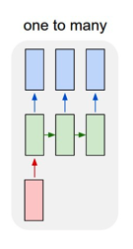
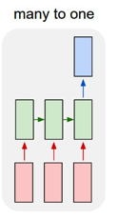
Seq2Seq
A successful variant of sequence models has been ‘seq to seq’ which is used for image captioning, nlp, text models. (Github, google)
Seq2Seq (source, Sutskever et al 2014) (nips paper)
Similar to Cho et al, 2014 (Source)
Seq2Vec (Source, Kimothi et al, 2016) – interesting biological application.
It constructs two steps we have seen before.
An encoder that is a many to one
A decoder that is a one to many.

Slide 19
Seq2Seq + Attention
(Source, 2014. Bahdanau, Cho & Bengio)
The problem with Seq2Seq is this idea of encoding a fixed length vector as the output.
the performance of a basic encoder–decoder deteriorates rapidly as the length of an input sentence increases
In this paper, we conjecture that the use of a fixed-length vector is a bottleneck in improving the performance of this basic encoder-decoder architecture, and propose to extend this by allowing a model to automatically (soft-)search for parts of a source sentence that are relevant to predicting a target word….. Instead, [this network] encodes the input sentence into a sequence of vectors and chooses a subset of these vectors adaptively while decoding the translation.

Slide 20
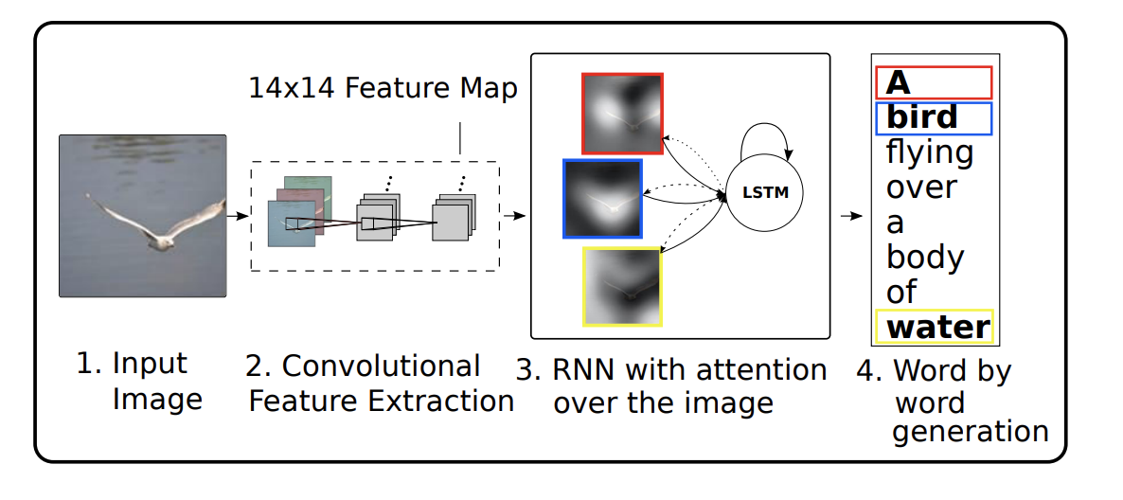
Seq2Seq + Attention + image captioning
Attention has also been very important in assisting with image captioning tasks.
(Nice video), (Nice article)
source
Attention helped to find the areas of interest when undertaking image captioning (Xu, Cho, Bengio et al 2015 Source):
“Inspired by recent work in machine translation and object detection, we introduce an attention based model that automatically learns to describe the content of images”

Slide 21
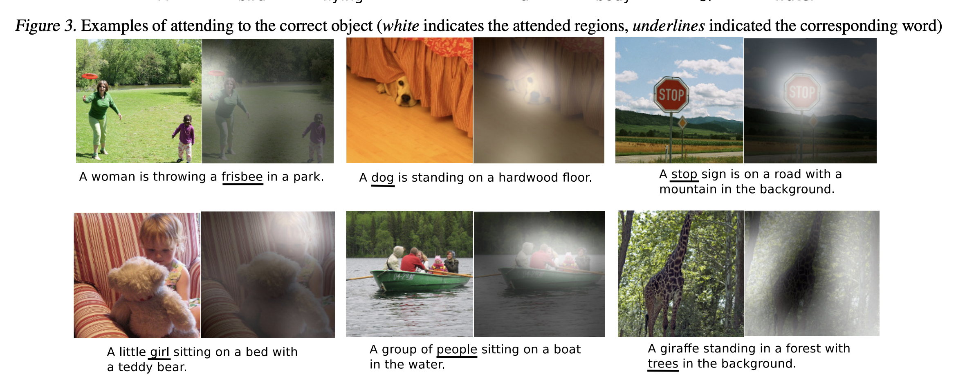
Attention + Image captioning Examples

Slide 22
Extension: The Transformer Unit
(Source, 2017)
Moving forward from encode-decoder networks that rely on an RNN or LSTM, this important paper introduced the ‘Transformer’ network.
Without going into too much detail, the key innovation was to remove the RNN/LSTM component completely and purely use attention-based mechanisms.

Slide 23


Guest Lecturer: Steve nouri from Nod

